Slide 1


Presentation
on
ONLINE SHOPPING STORE
Submitted by:
Pallavi Kankute (36066)
Prathamesh Kulkarni (36074)
Rahul Narode (36079)
Guided by:
Prof.Pankaj Durole

Slide 2
Why choose a Online Mobile Software ?
This project is aimed at developing a Web application that depicts online Shopping of mobiles and purchasing using Payment Gateway. Using this software, companies can improve the efficiency of their Services. Online Shopping is one of the applications to improve the marketing of the company’s products.
This web application involves all the features of the online shopping.
The Database Online Mobile System is intended to Automate the Online activities such as :
In an e-commerce application, the main purpose of a database is to store information for retrieving the product details.
customer information.
track transactions. and further, maintain the inventory.
One of the biggest benefits of using a database for e-commerce is structuring vast amounts of shop data.

Slide 3
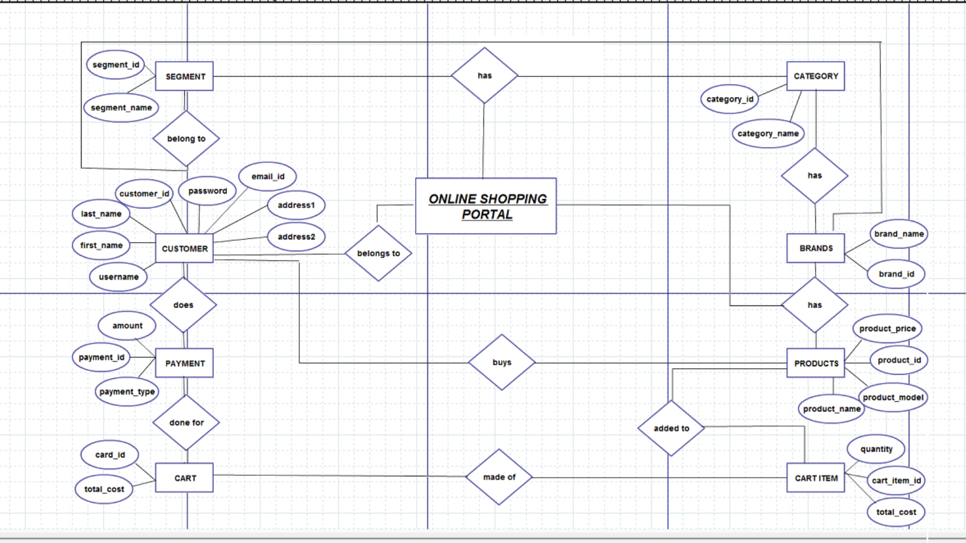
E-R Diagram:

Slide 4
Relational Model of ERD
Brand
brand_name brand_name
Products
product_price product_id product_model product_name
Customer
customer_id customer_name user_name mobile_number password address

Slide 5
Carts
product_id product_name total_cost
Payment
payment_id payment_id amount payment_type product_id
Admin
admin_name admin_id user_name password

Slide 6
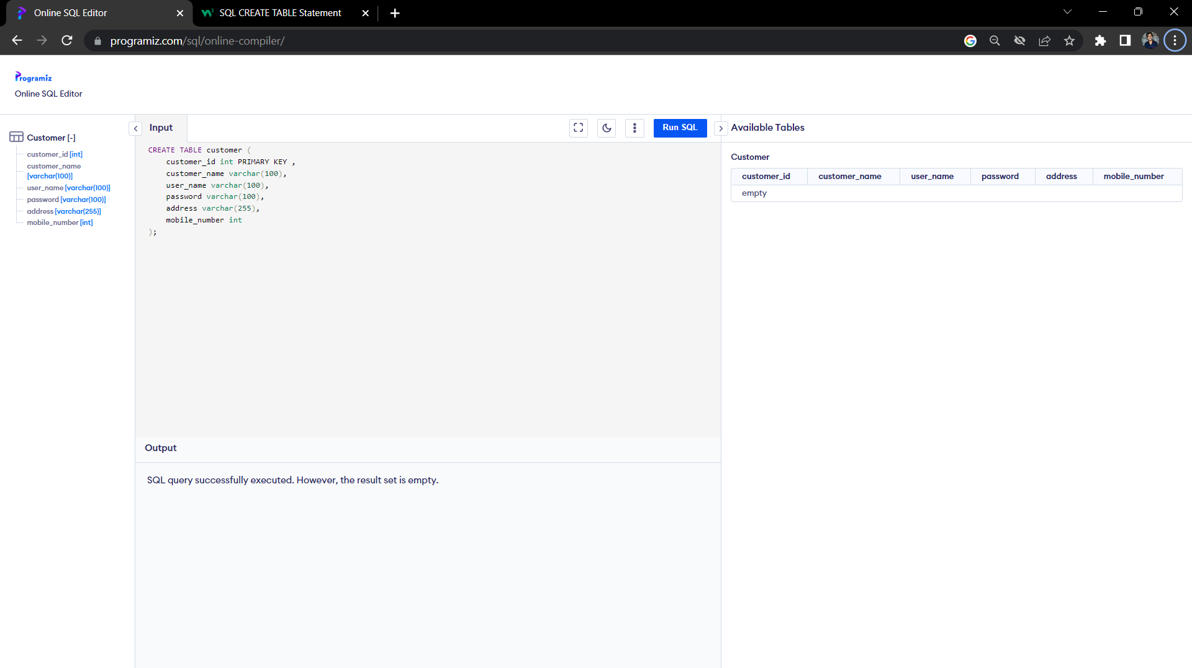
SQL Queries :
DDL (Data Defination Language) Queries:
Create Command :

Slide 7
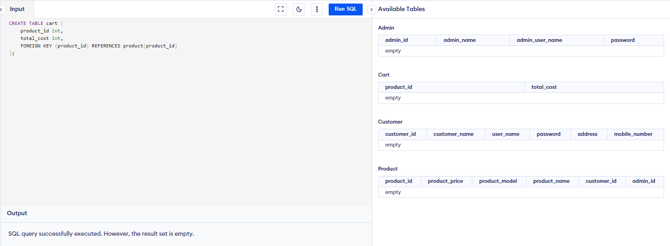
k
SQL Queries :
DDL (Data Defination Language) Queries:
Create Command :

Slide 8
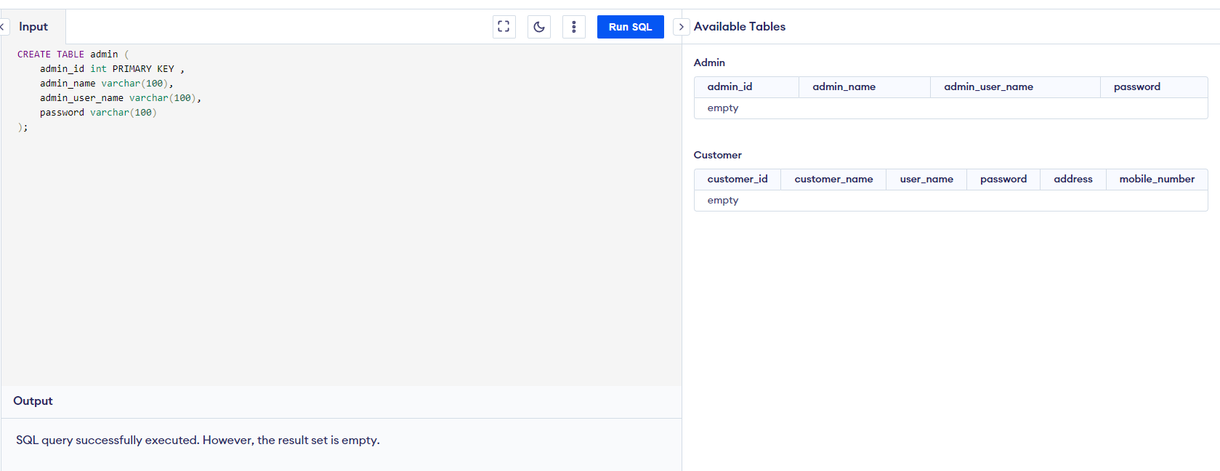
SQL Queries :
DDL (Data Defination Language) Queries:
Create Command :

Slide 9
SQL Queries :
DDL (Data Defination Language) Queries:
Create Command :

Slide 10
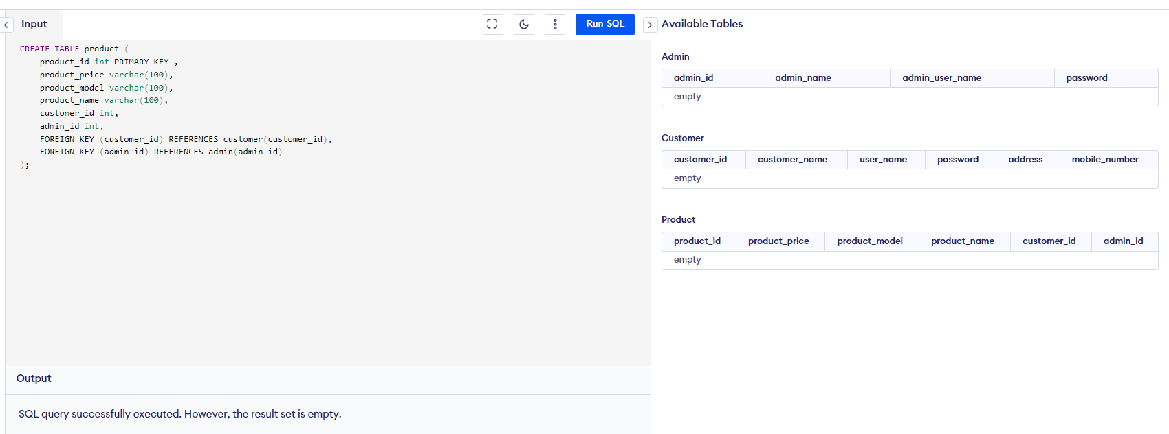
SQL Queries :
DDL (Data Defination Language) Queries:
Create Command :

Slide 11
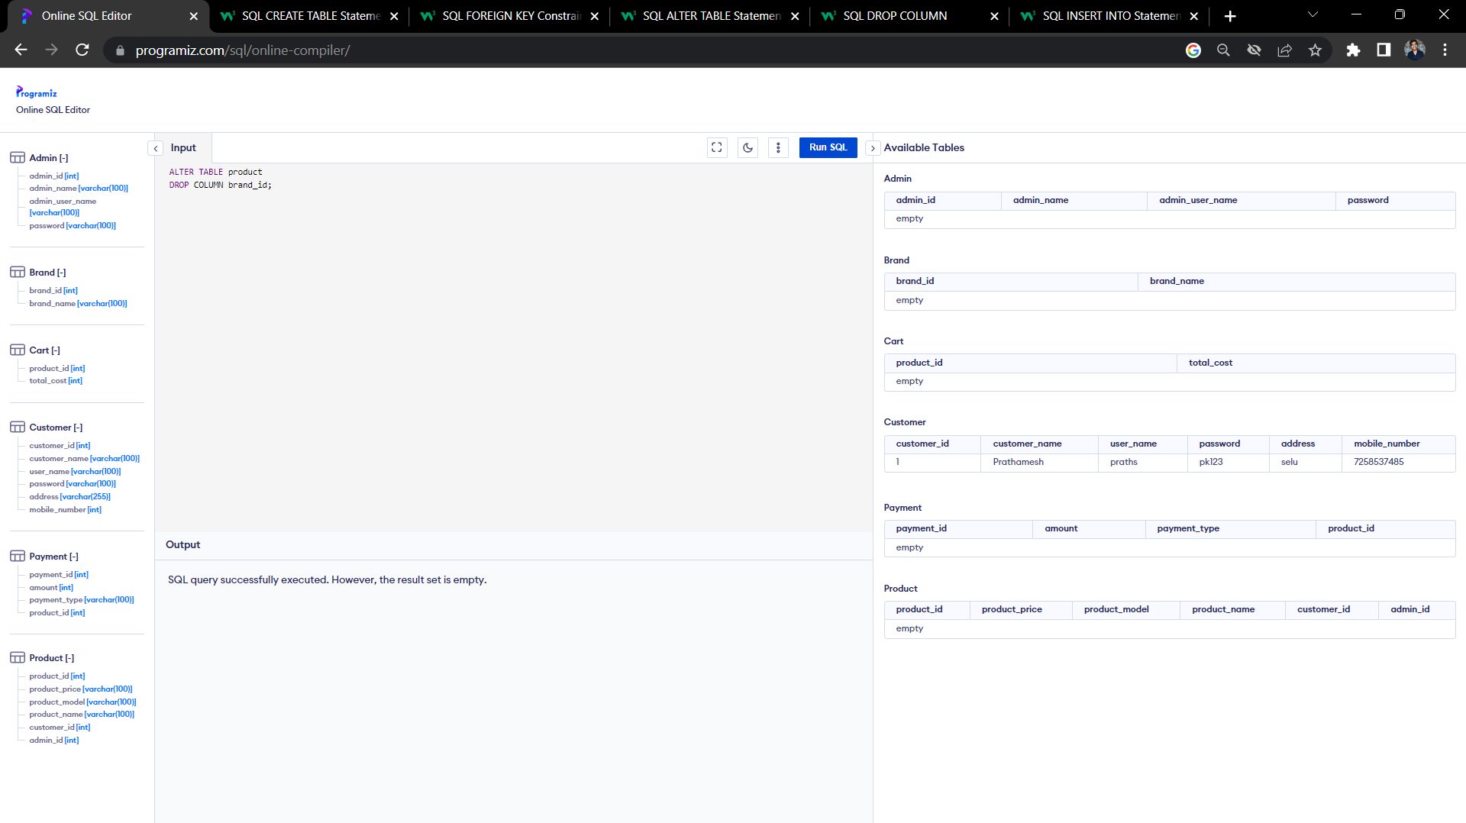
Alter Command :

Slide 12
Drop Command :

Slide 13

DML (Data Manipulation Language) Queries:
Insert Command:

Slide 14
DML (Data Manipulation Language) Queries:
Insert Command:

Slide 15
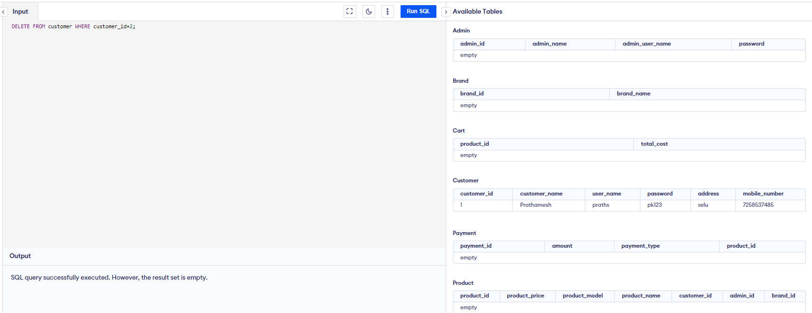
Delete Command:

Slide 16
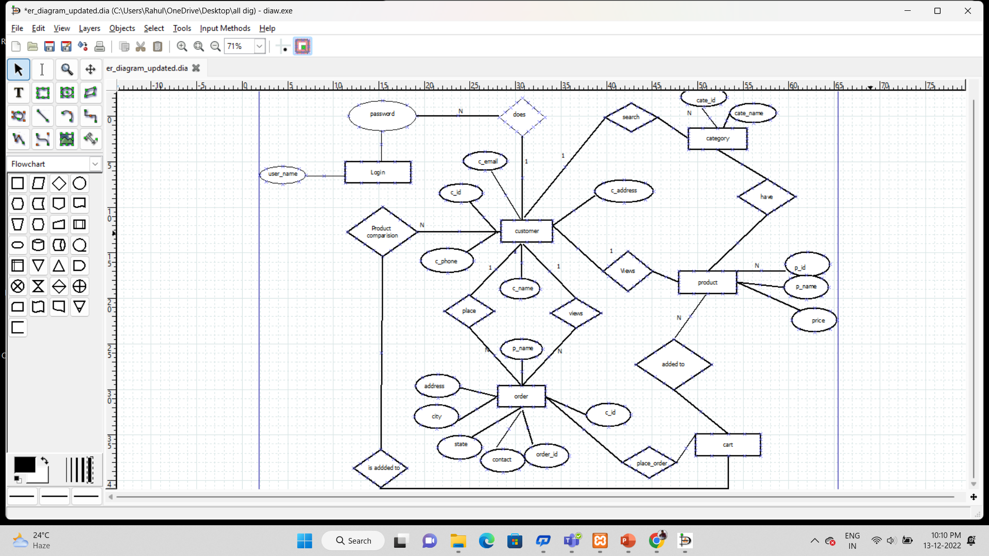
Thank You !
Updated ER dig

Slide 17
SCHEMA
1.customer(c_id,c_name,c_phone,c_email,c_address) 2. order(order_id,o_name,c_id,contact,state,city)
3. product(p_name,p_id,price)
4. cart(quantity,prod_price,prod_id)
5. login(user_name,passward)
6. category(cat_name,cat_id)

Slide 18
Customer table
1NF
we can see that the c_phone_no Number column has two values. Thus it violated the 1st NF. Now if we apply the 1st NF to the above table we get the below table as the result.
C_id | C_name | C_phone_no | C_mail | C_Adress
1 | PRATHAMESH kULKARNI | 9586889655,9586252126 | prathamesh@gmail.com | PUNE
2 | RAHUL NARODE | 95865265566 | rahul@gmail.com | GOA
3 | PALLAVI KANKUTE | +91 9772342113 | pallavi@gmail.com | MUMBAI
C_id | C_name | C_phone_no | C_mail | C_Adress
1 | PRATHAMESH kULKARNI | 9586889655 | kabibansode@gmail.com | PUNE
2 | RAHUL NARODE | 9586252126 | kabibansode@gmail.com | PUNE
3 | PALLAVI KANKUTE | 95865265566 | kjoshi@gmail.com | GOA

Slide 19
> 2NF
1. Super key: {c_id,{c_id,c_name,c_phone_no}}
Candidate key:{c_id ,c_name}
2.The given table is in 1NF.
3.There is no partial dependency.
Therefore given table is in 2NF.

Slide 20
Normalization of table :
Product table
1NF
Given table is in 1NF because it contain Atomic value.
2NF
The given table is in 1NF.
There is no partial dependency.
Therefore given table is in 2NF.
product_id | product_name | product_price
121 | Samsung | 89900
122 | Apple | 152000
123 | Redmi | 10200

Slide 21
3NF
The given table is in 2NF
There is transitivity because prod_id -> prod_name and prod_name -> prod_price
3. So to remove transitivity we need to split the table.
product_id | product_name
121 | Samsung
122 | Apple
123 | Redmi
product_name | product_price
121 | 89900
122 | 152000
123 | 10200

Slide 22
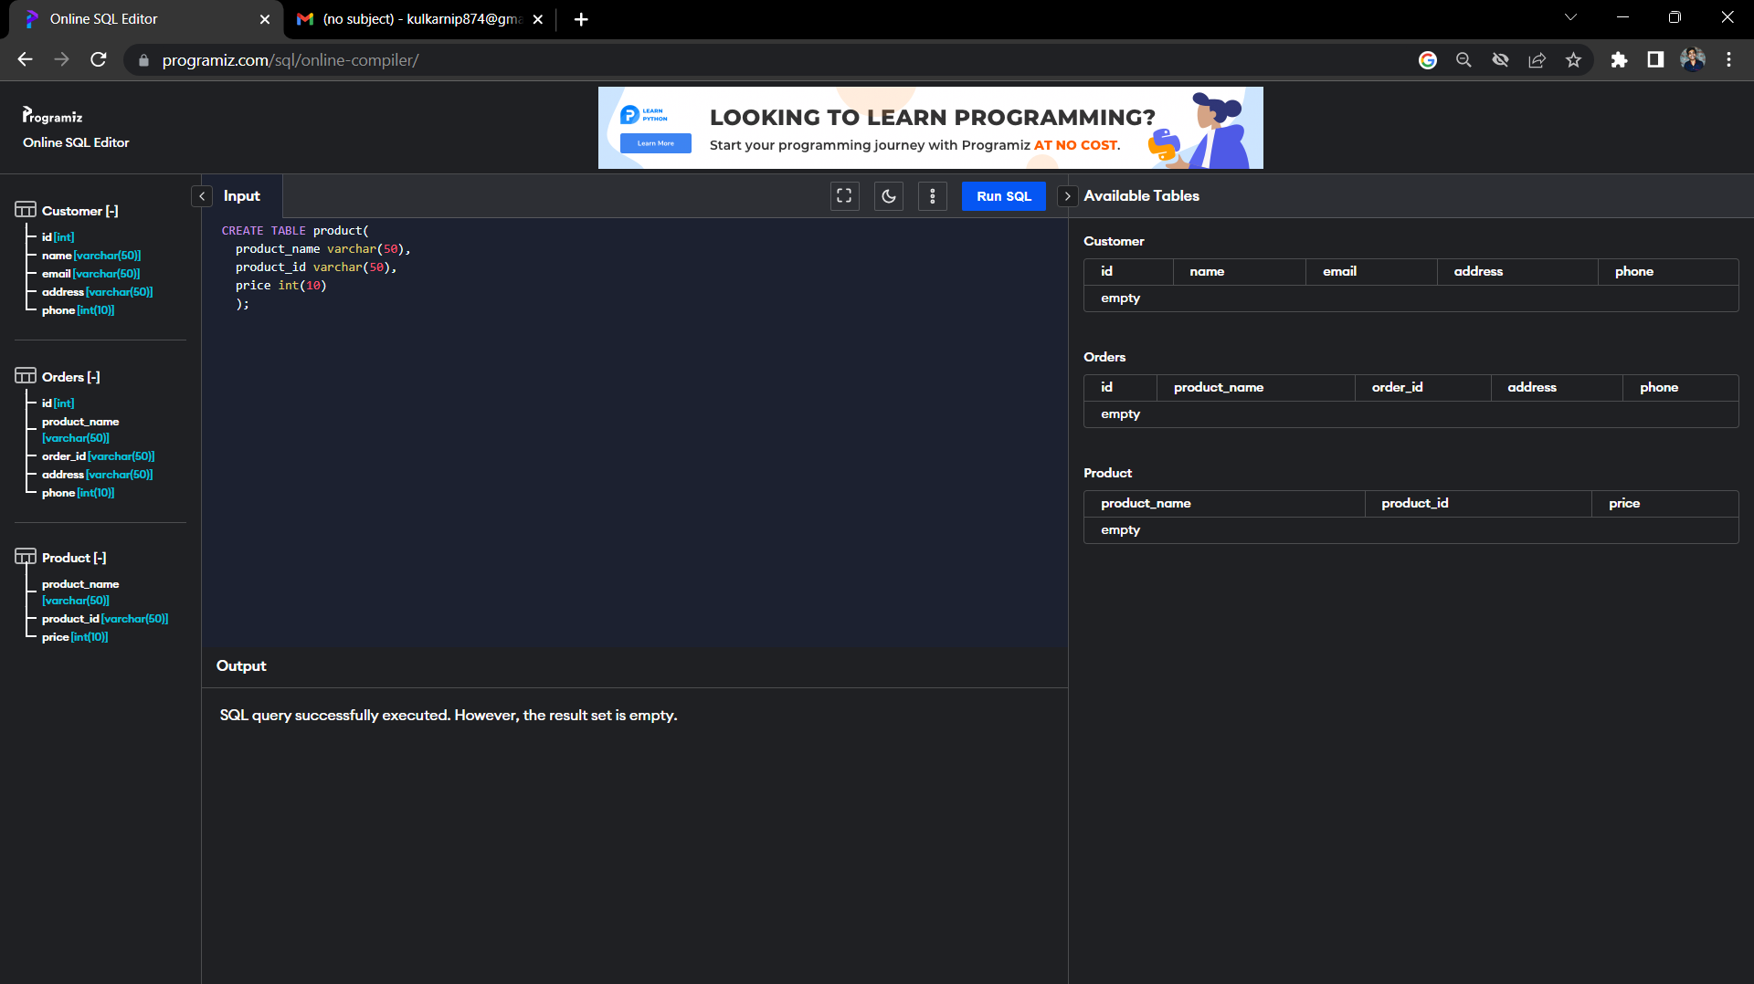
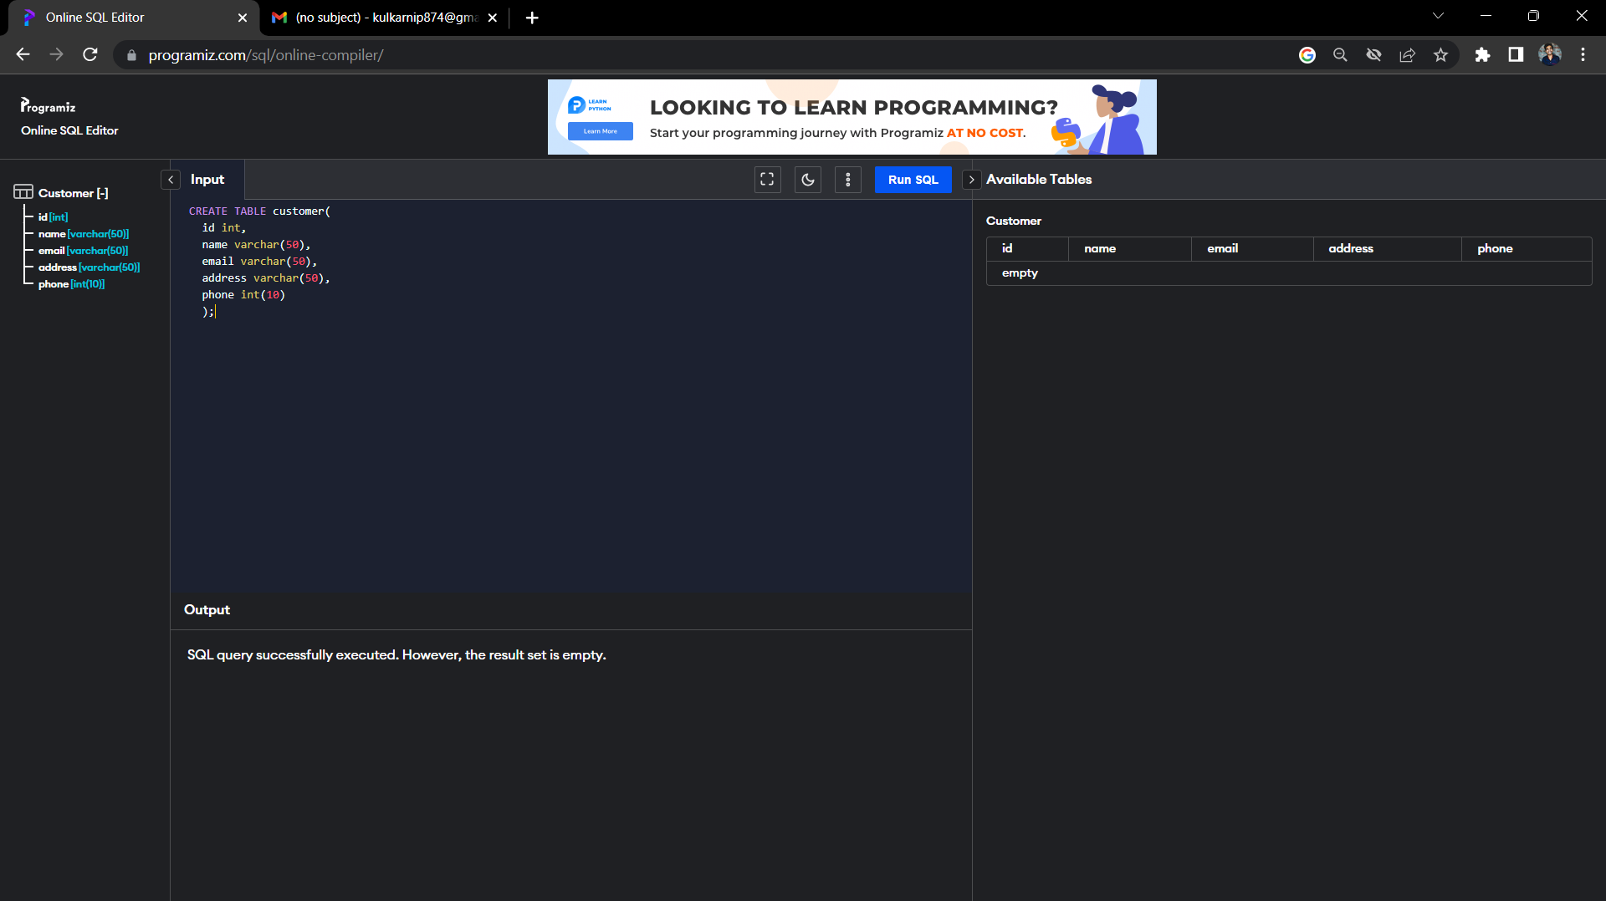
Create Table
Customer
Product

Slide 23
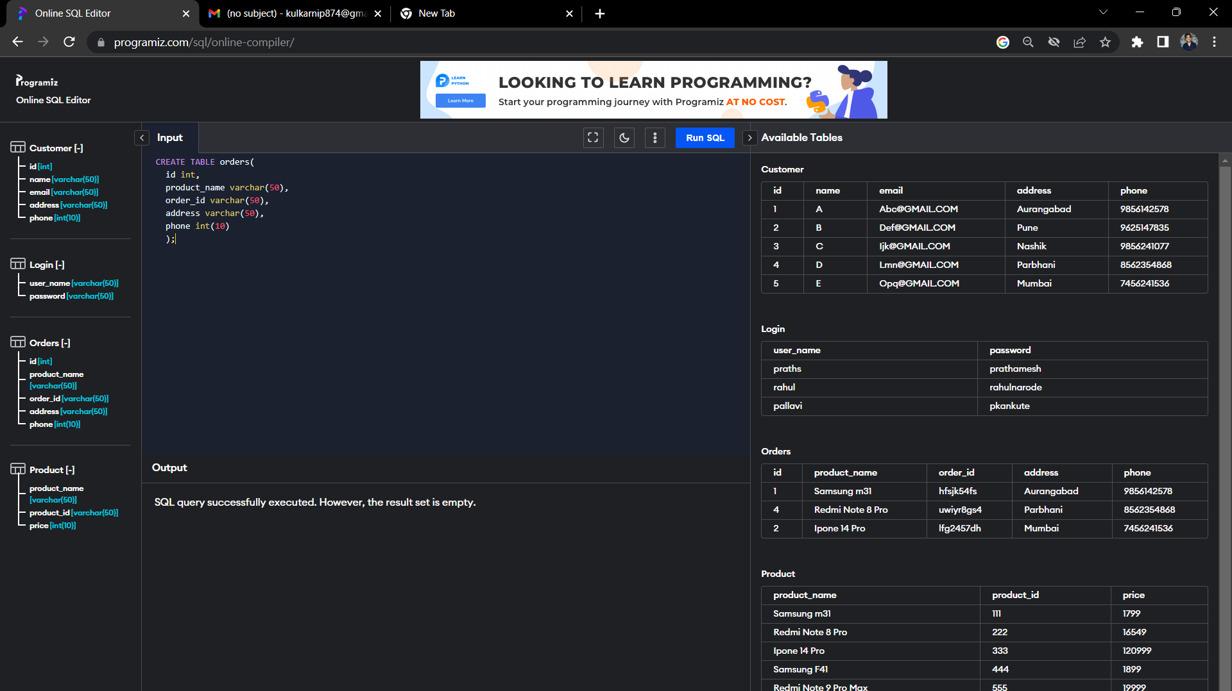
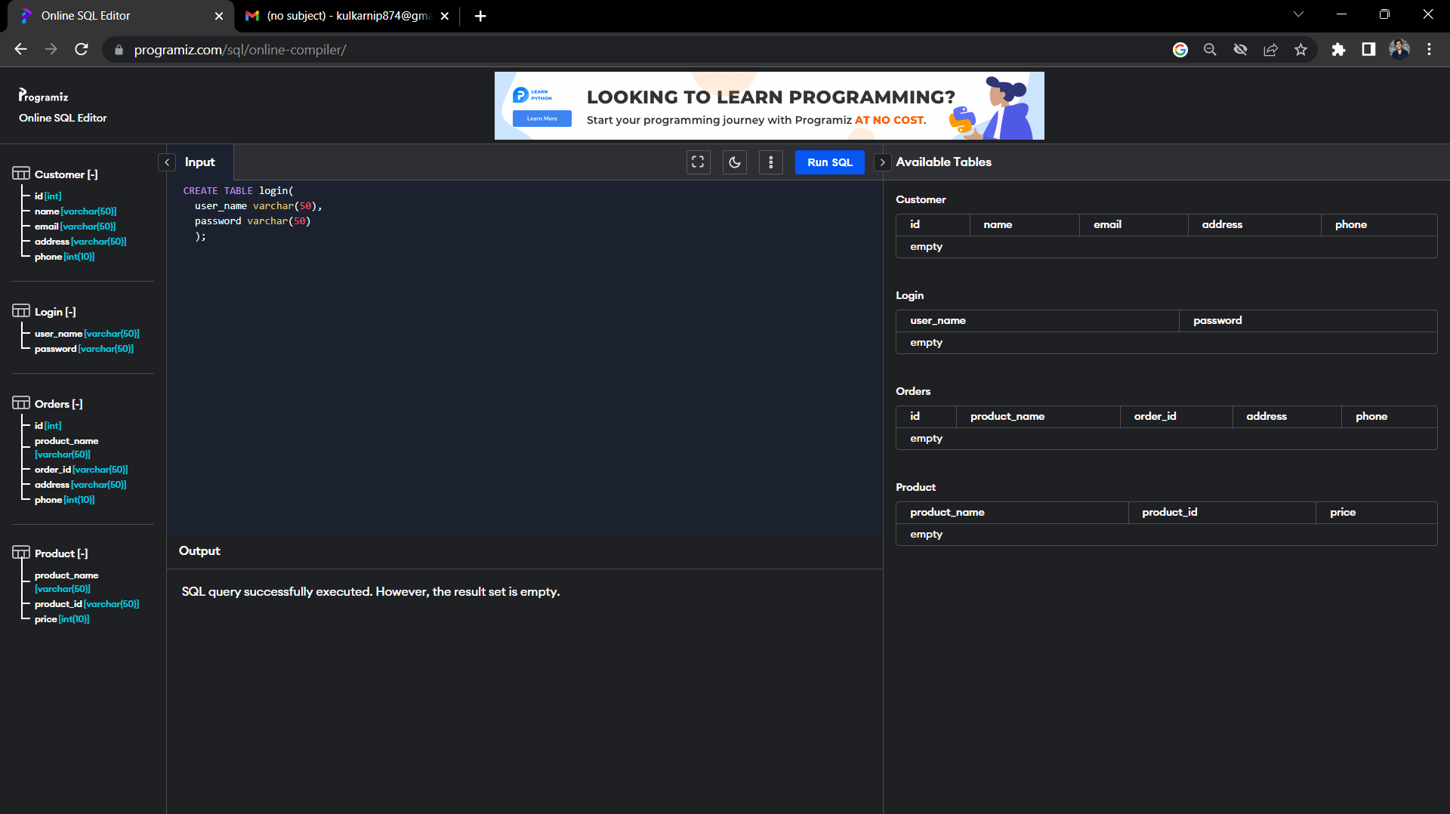
Create Table
Orders
Login

Slide 24
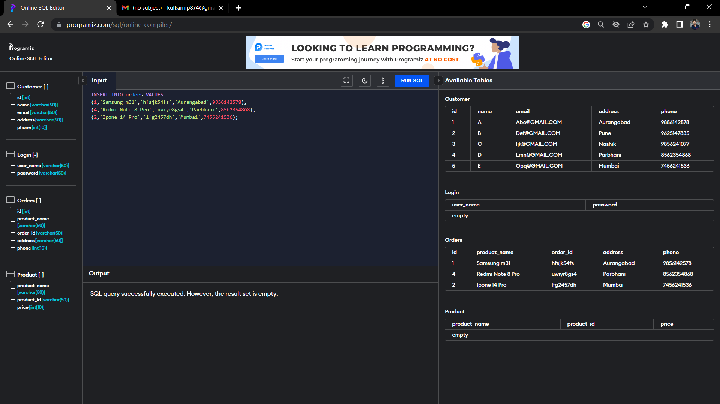
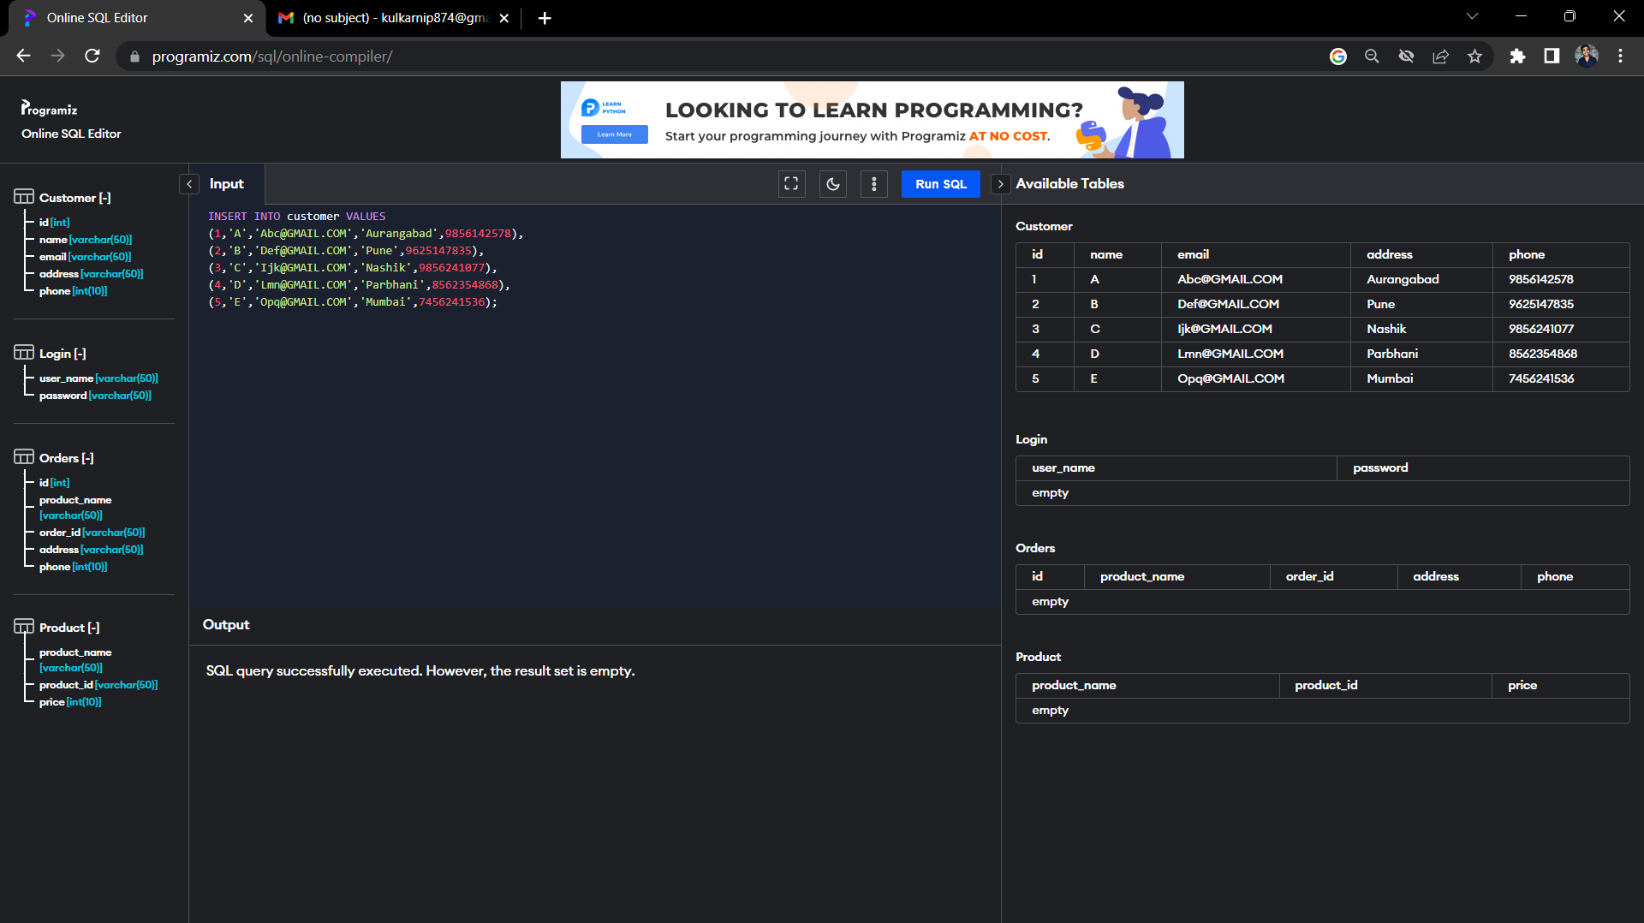
Insert Values in Table

Slide 25
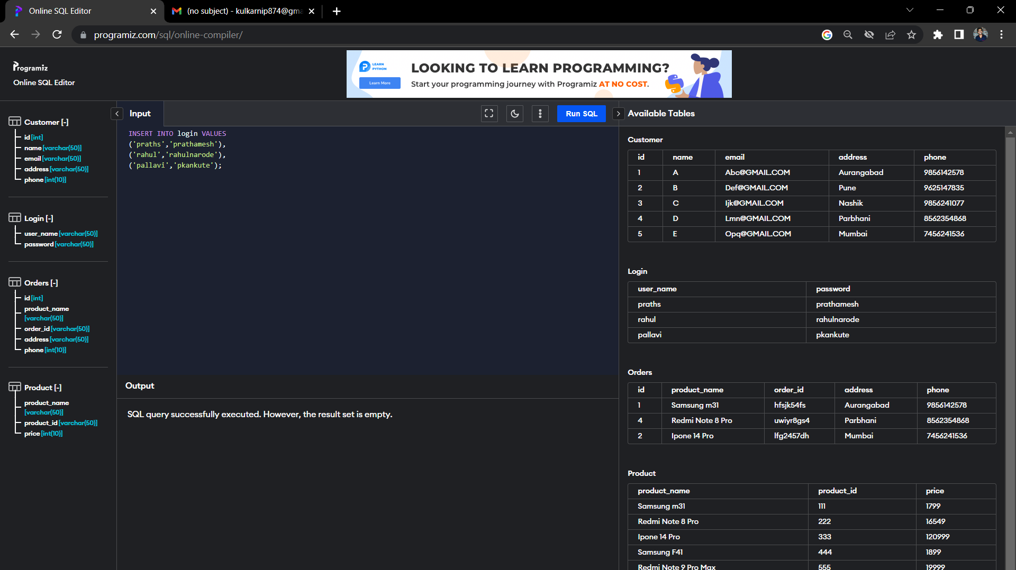
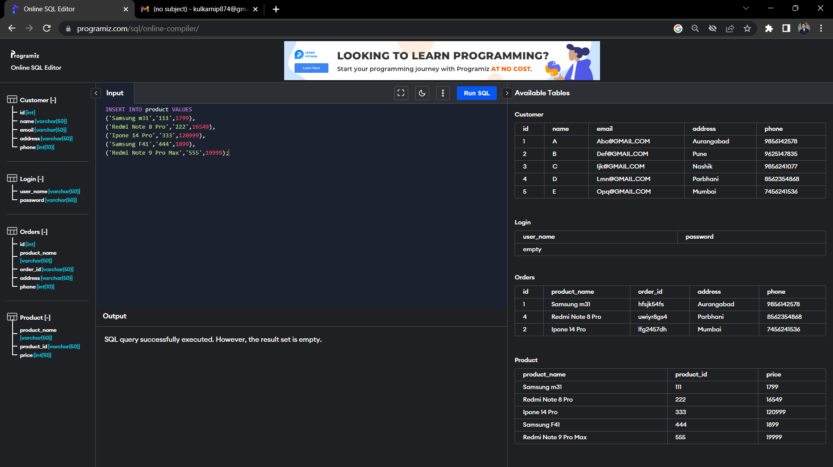
Insert Values in Table

Slide 26
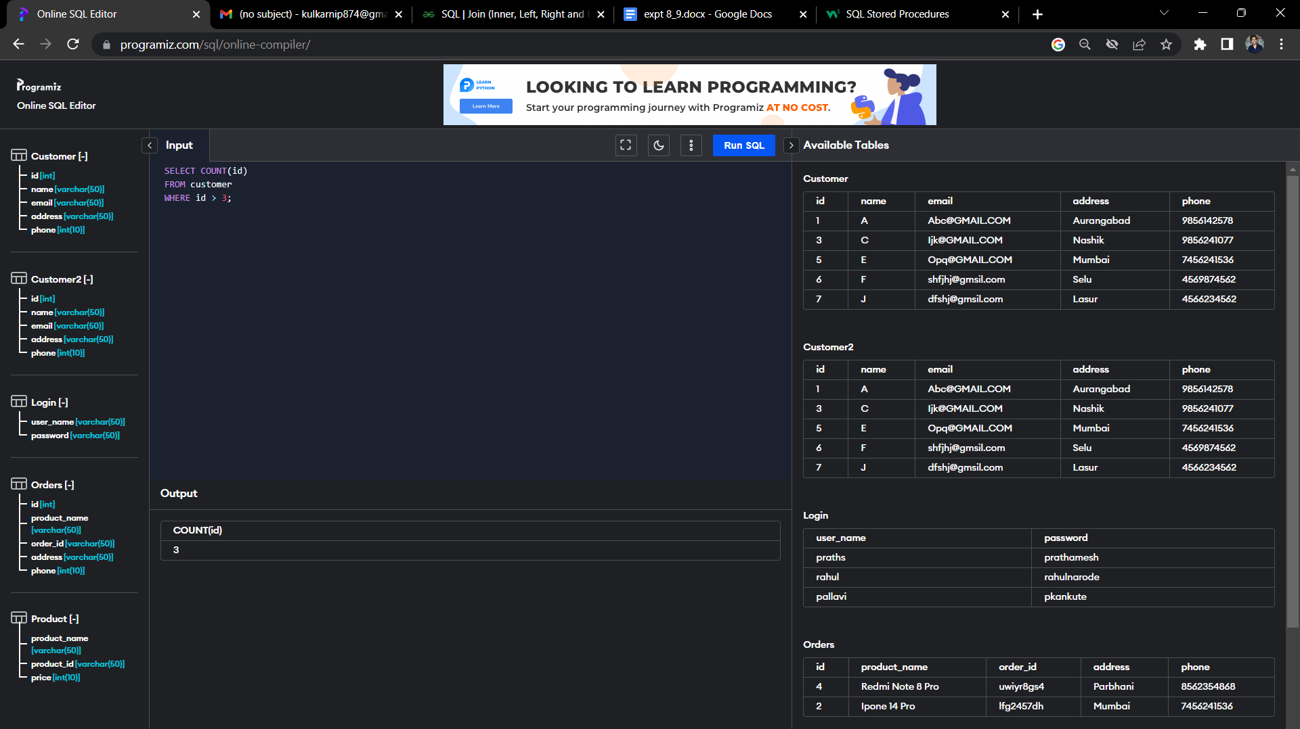
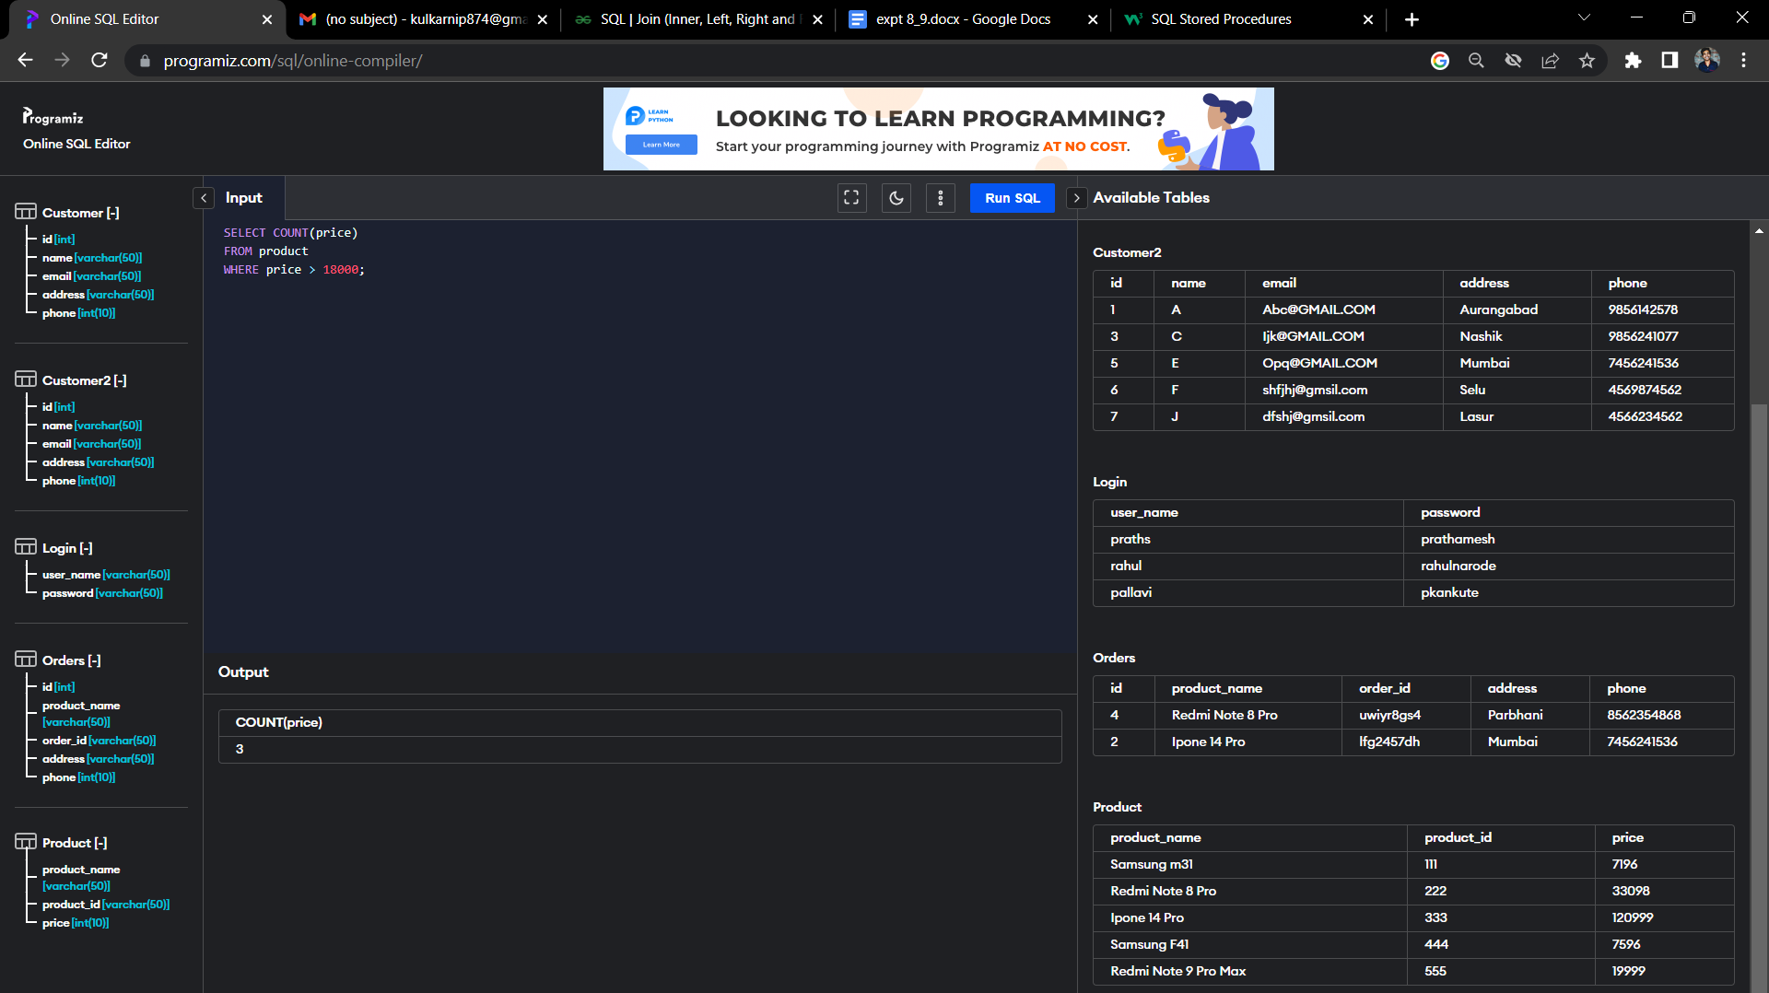
Aggregrate Functions :
Count:-

Slide 27
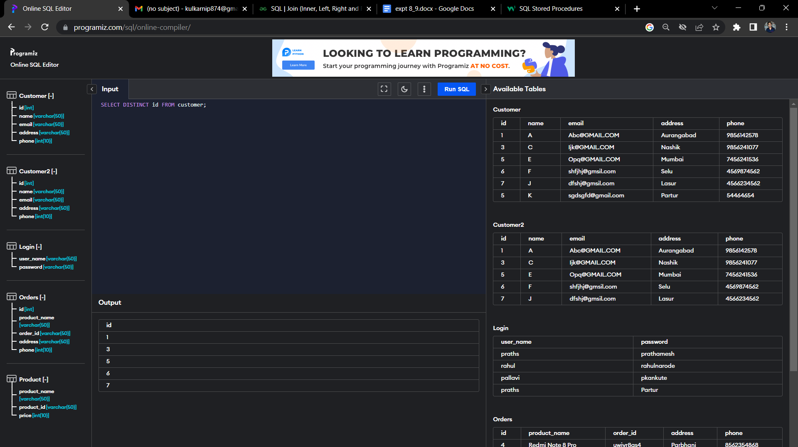
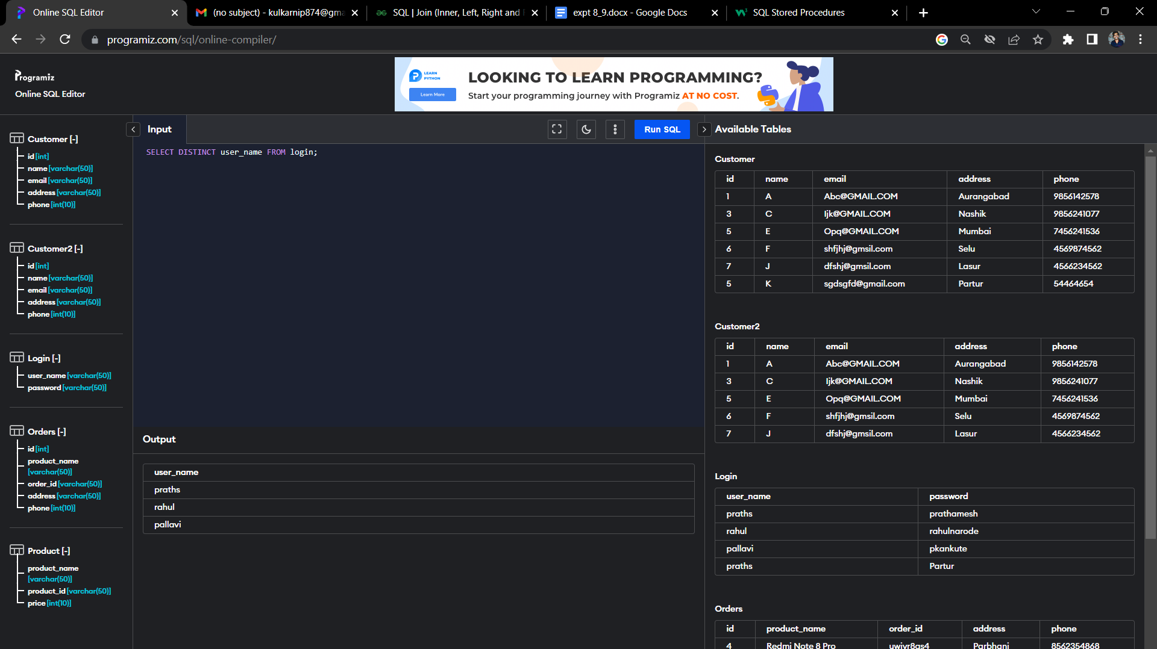
Distinct:

Slide 28
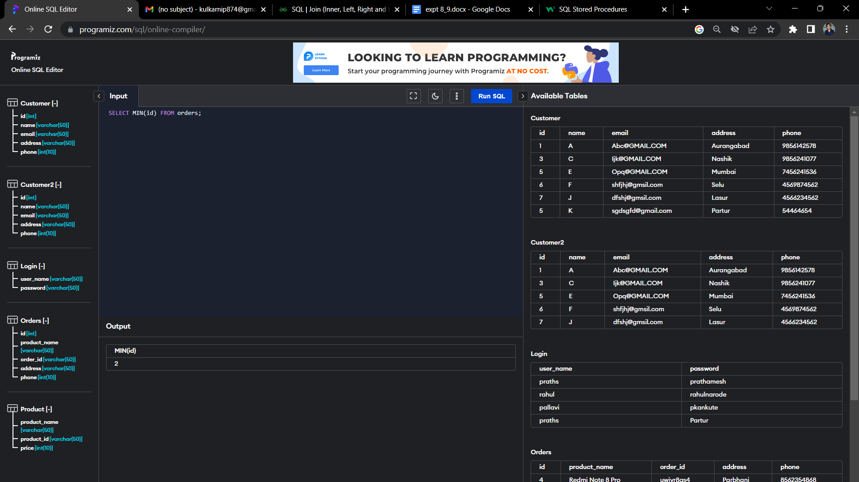

Min

Slide 29
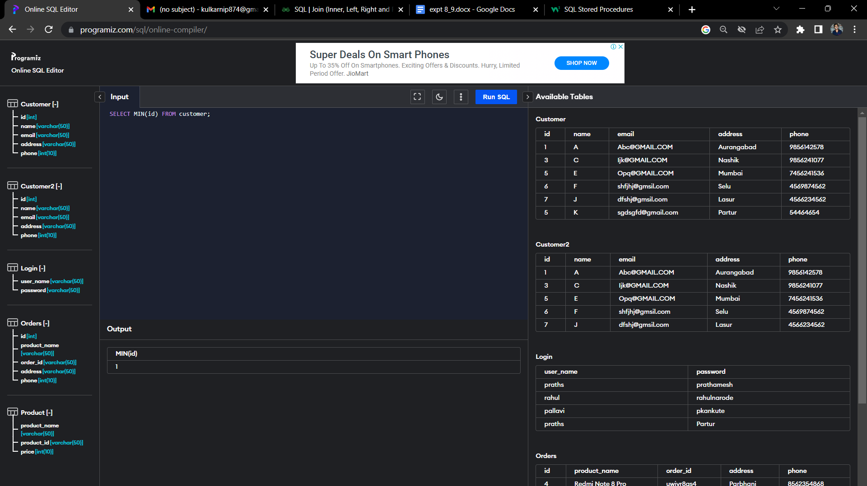
Min

Slide 30


Max :
Table 1:

Slide 31

Max :

Slide 32


Sum:

Slide 33

Sum:
Table 3:

Slide 34


Average:
Table 1:
Table 2:

Slide 35

Average:

Slide 36
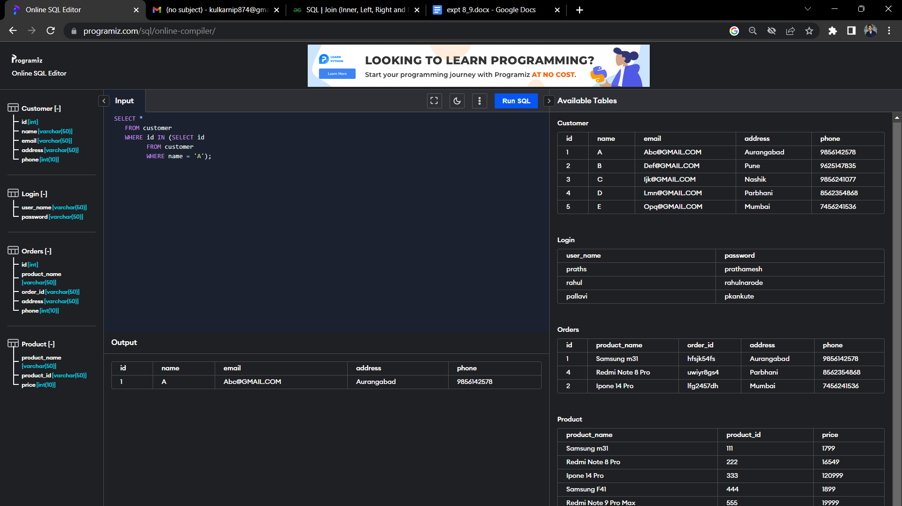

Nested Queries:
Select
Table 1:

Slide 37
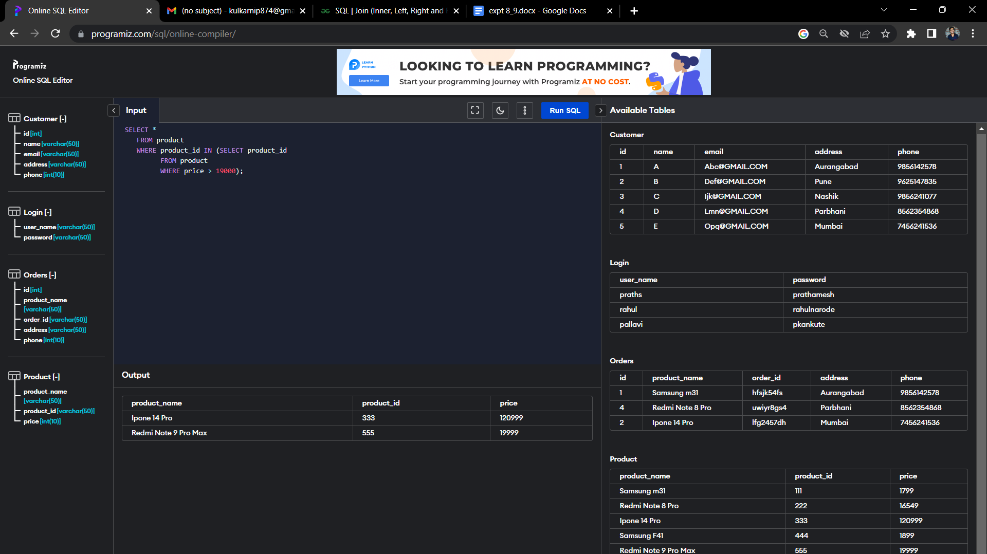
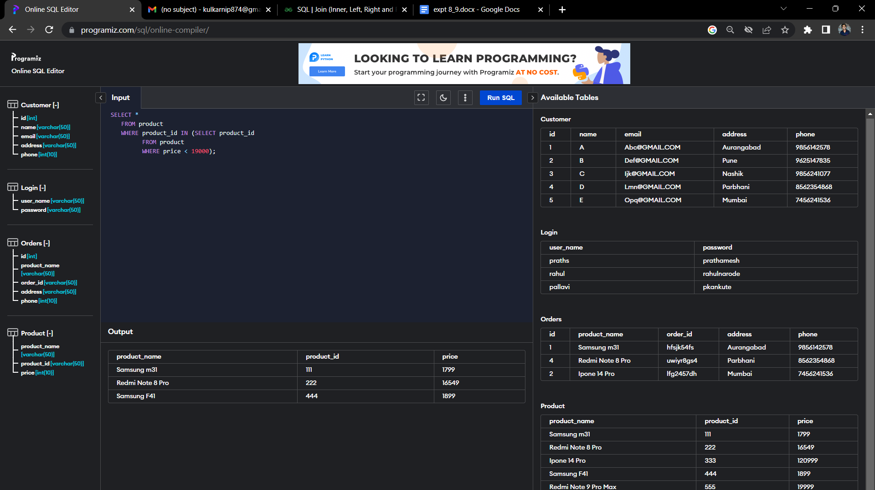
Nested Queries:
Select

Slide 38


Nested Queries:
Select

Slide 39
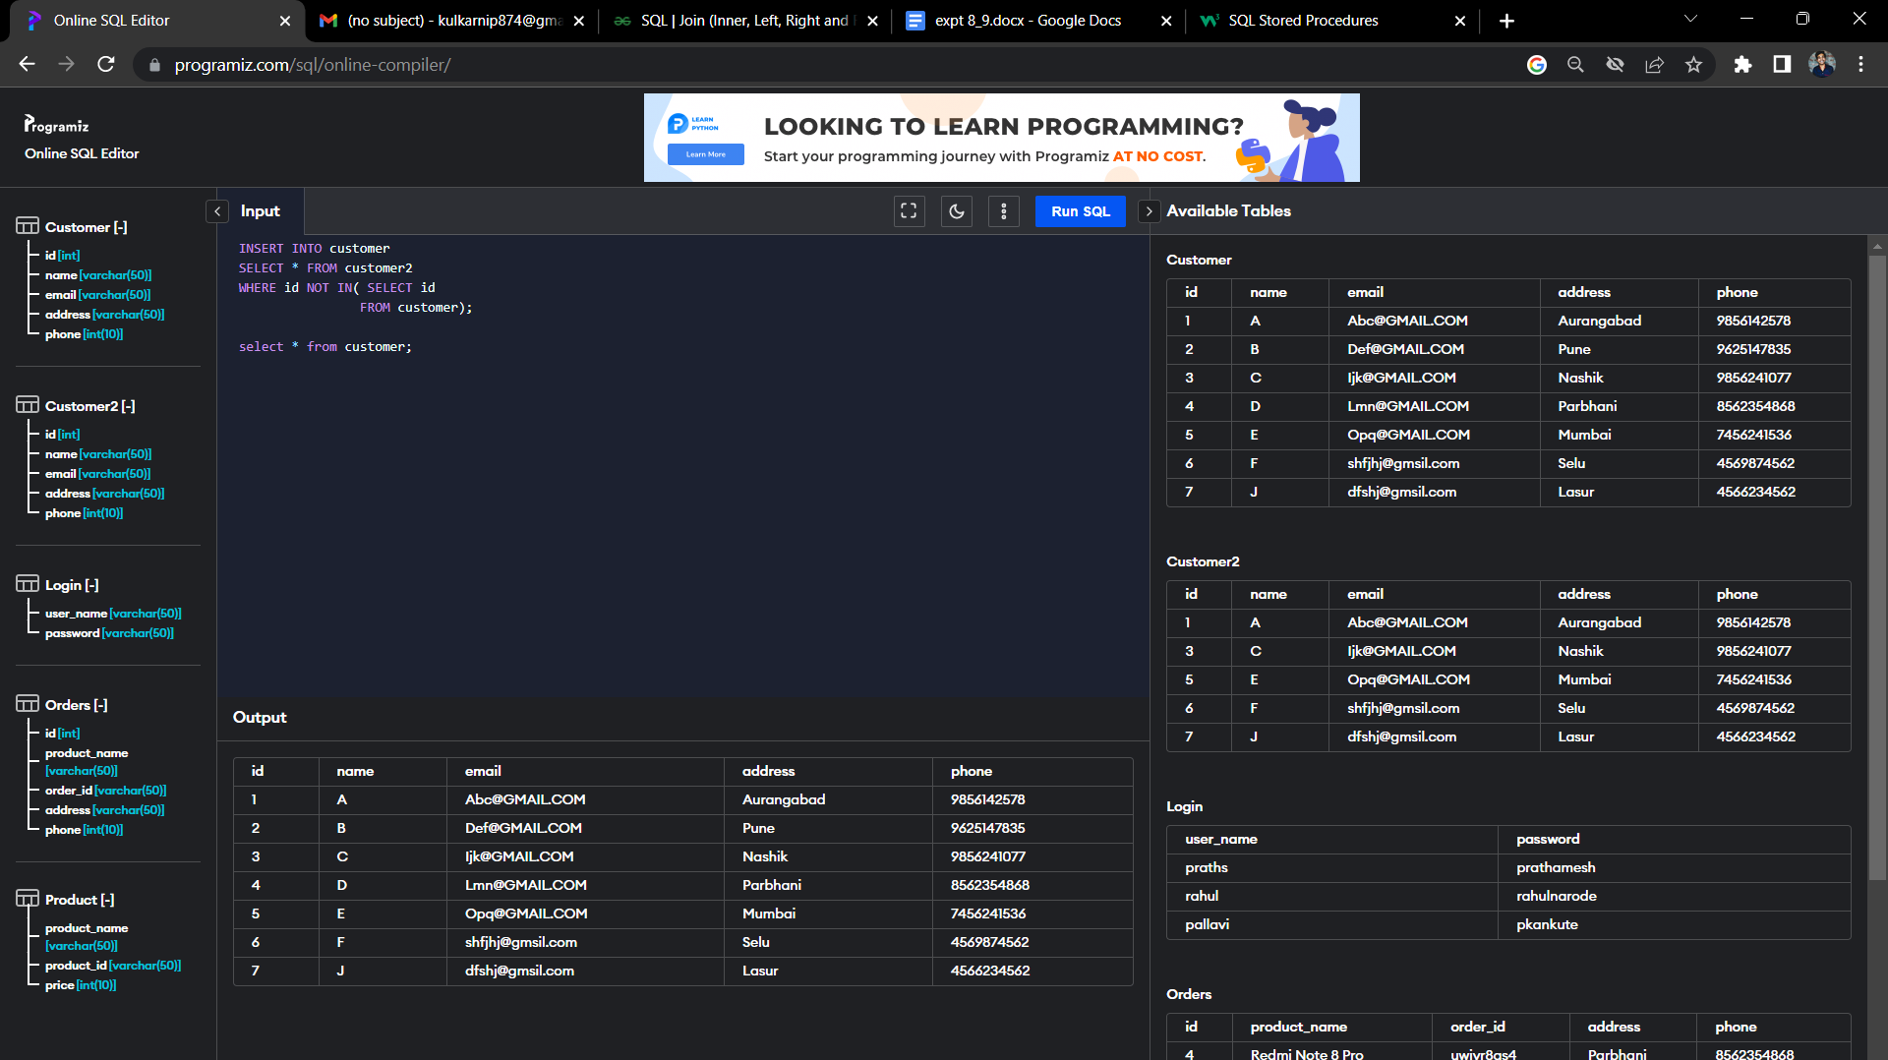
Insert:

Slide 40


Update:

Slide 41
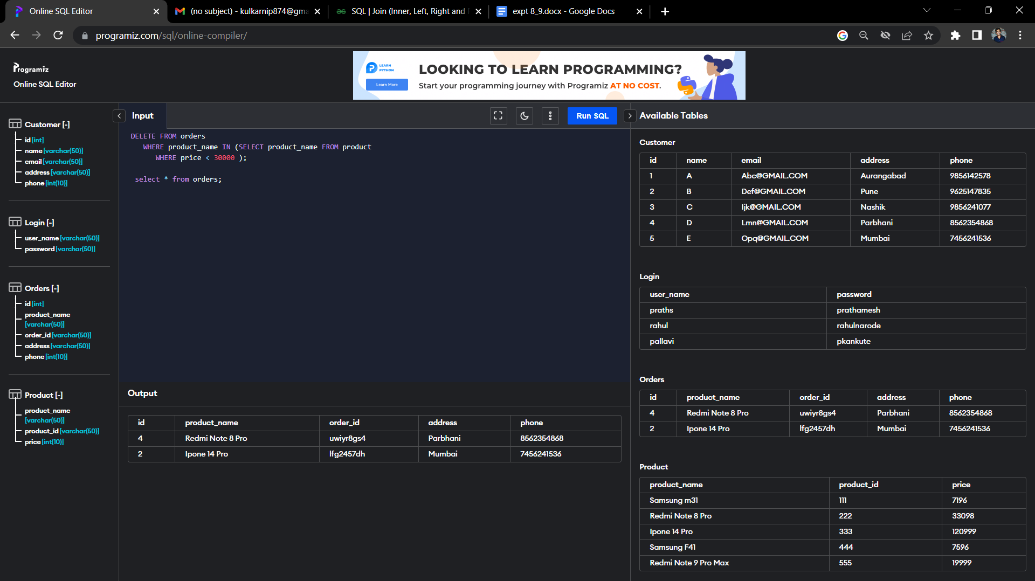
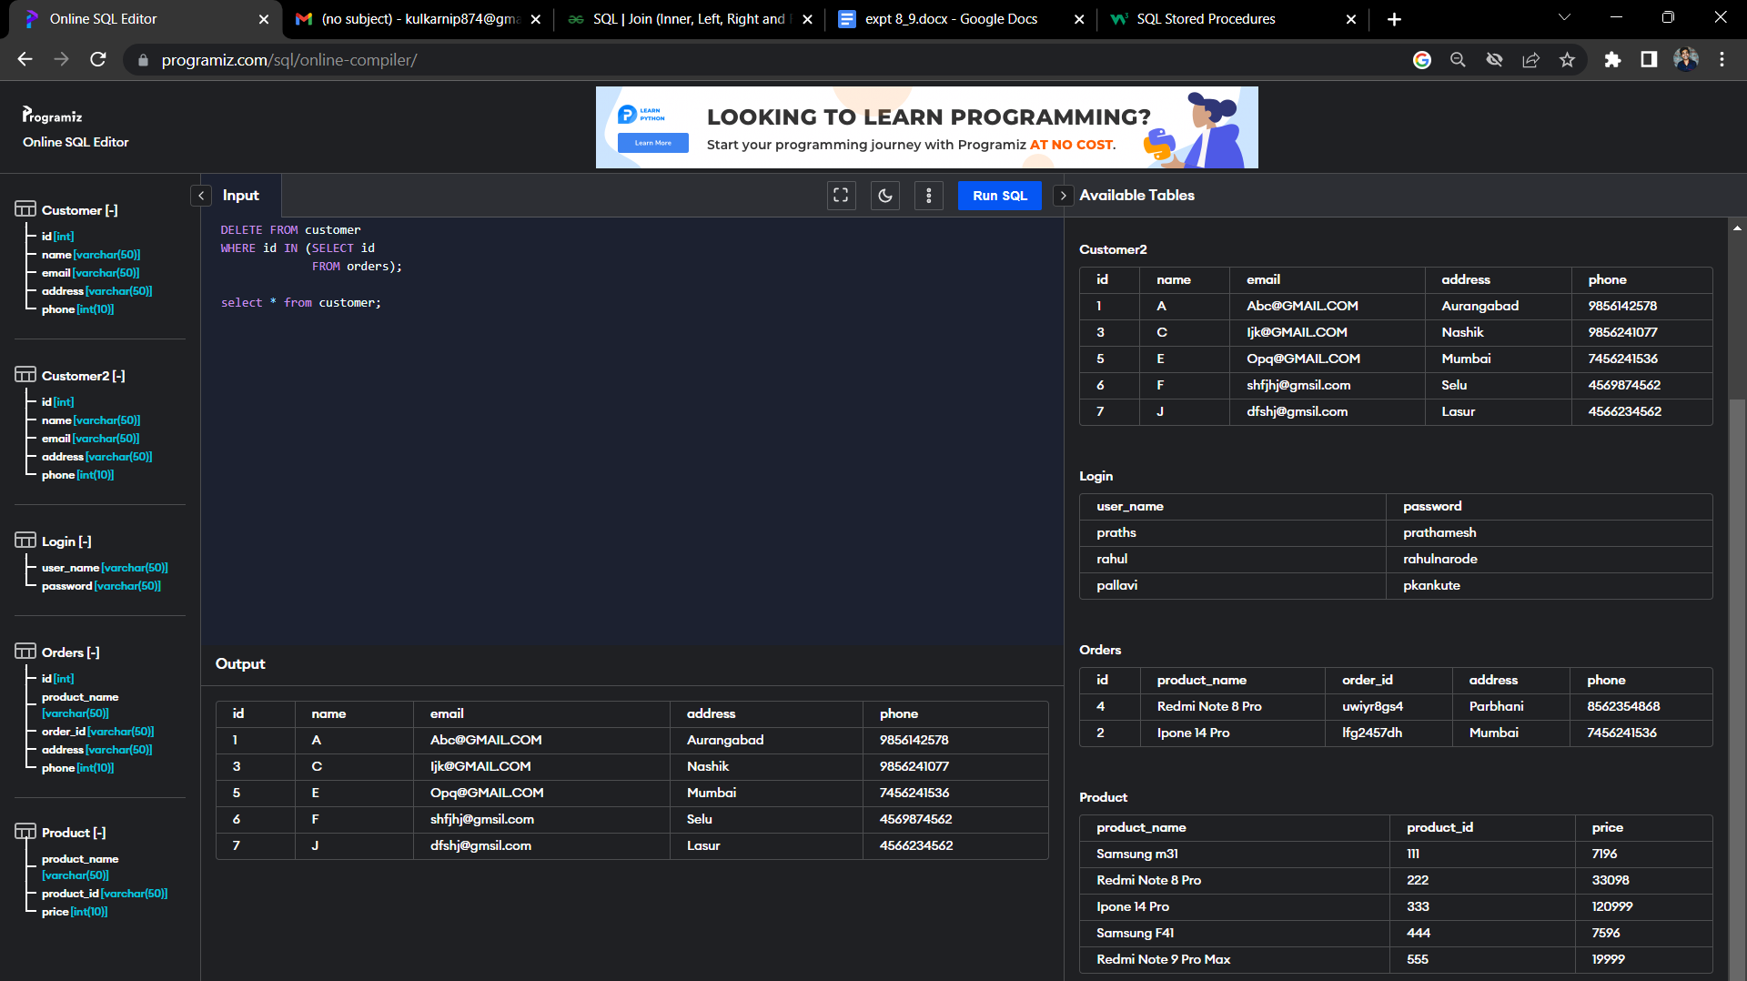
Delete:

Slide 42
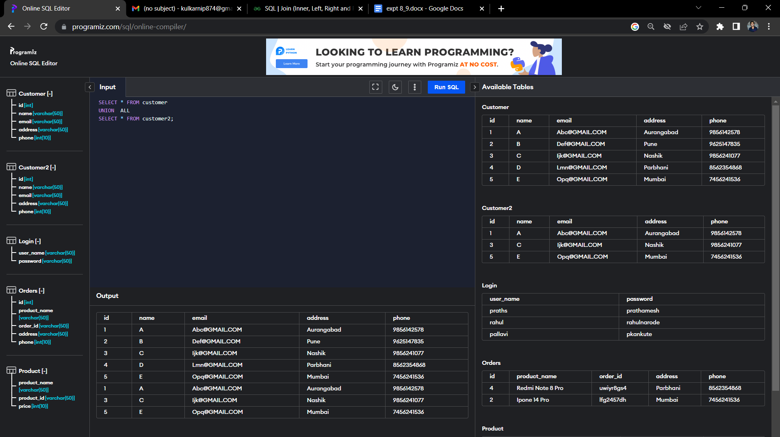
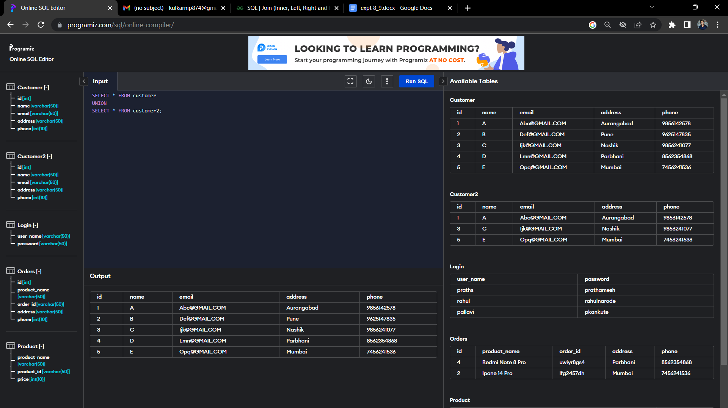
Set Operation

Slide 43
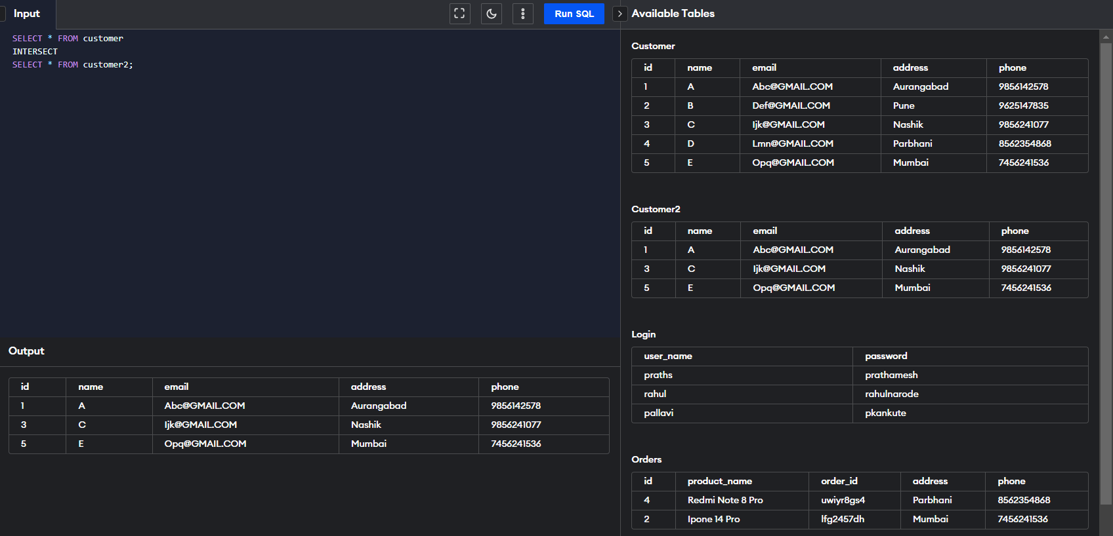
Set Operation

Slide 44
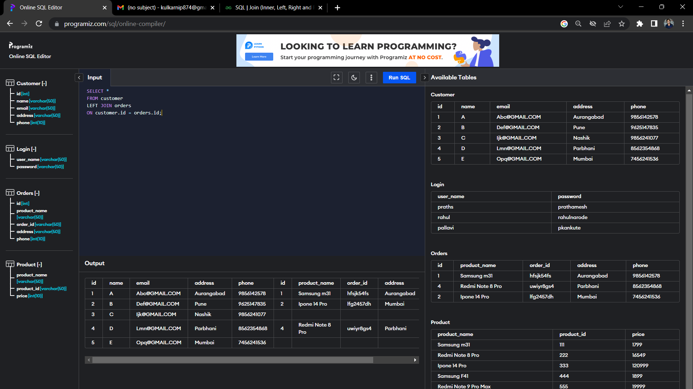
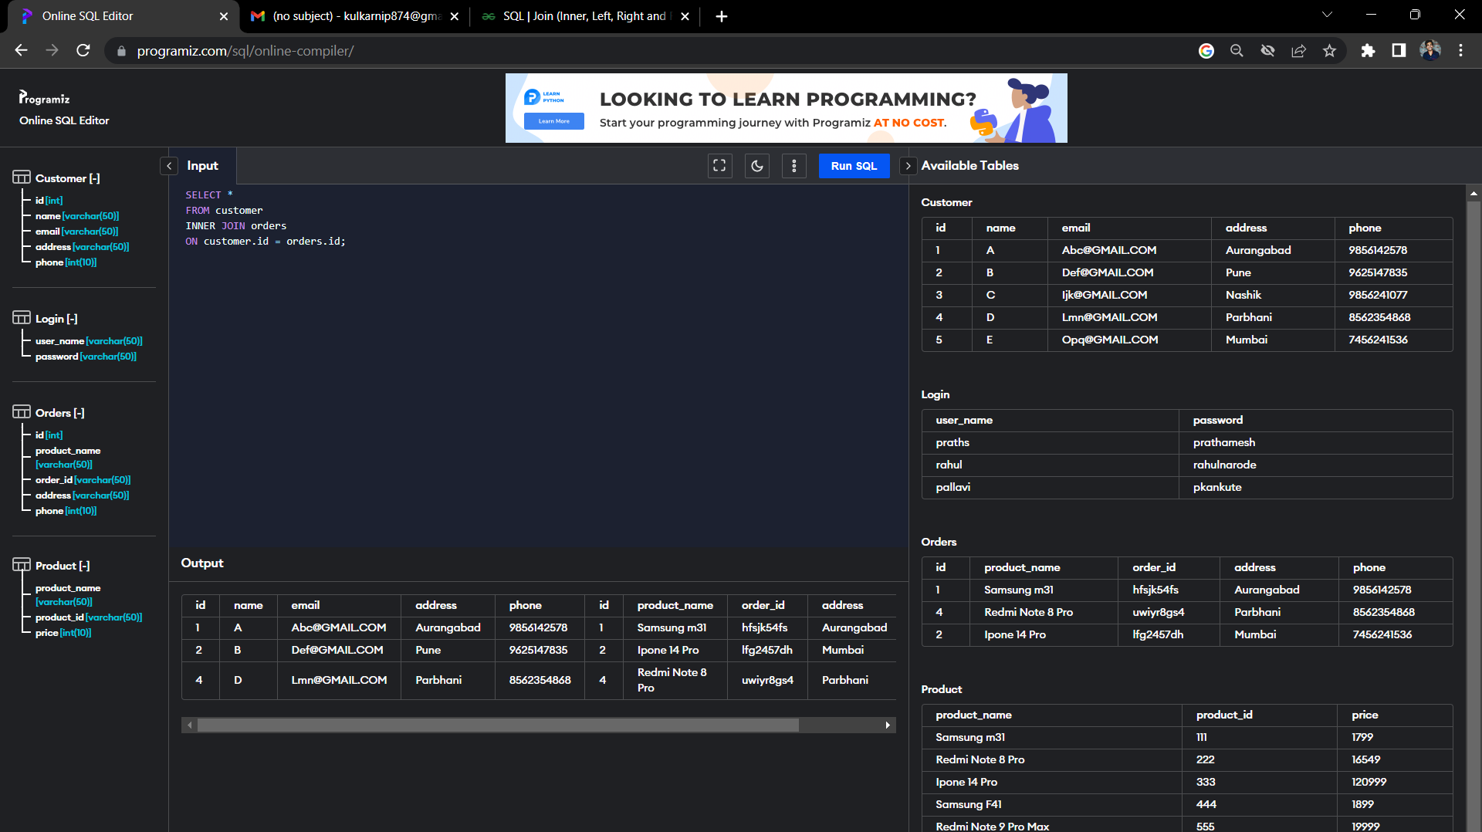
Join

Slide 45
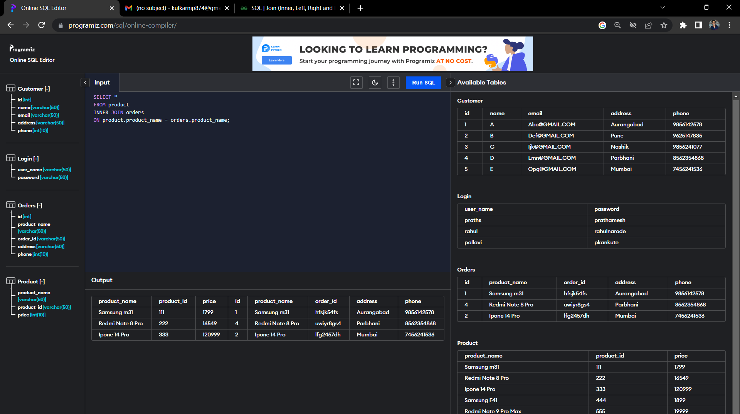
Join

Slide 46
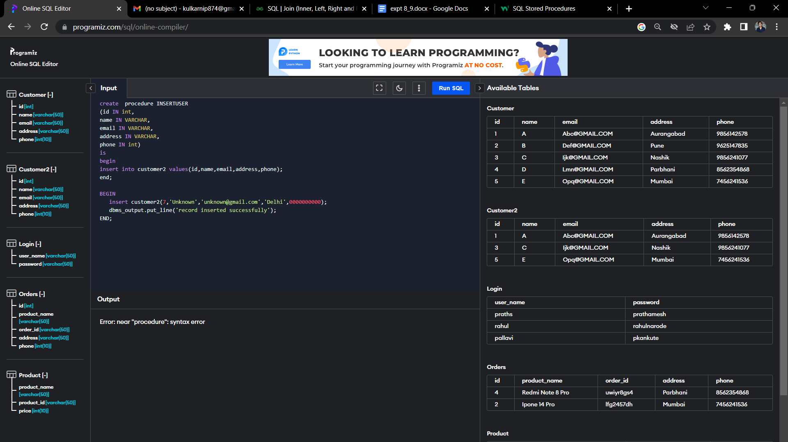
Procedure

Slide 47
Functions:
What is a function ?
A function is a stored program that you can pass parameters into and return a value.
Create Function
A standalone function is created using the Create function statement. The simplified syntax for the CREATE OR REPLACE PROCEDURE statement is as follows −
Syntax
CREATE [OR REPLACE] FUNCTION function_name
[(parameter_name [IN | OUT | IN OUT] type [, ...])]
RETURN return_datatype
{IS | AS}
BEGIN
< function_body >
END [function_name] ;

Slide 48
Calling a Function:
When a program calls a function, the program control is transferred to the called function. A called function performs the defined task and when its return statement is executed or when the last end statement is reached, it returns the program control back to the main program.
Syntax:
DECLARE
c number(2);
BEGIN
c := totalCustomers(); dbms_output.put_line('Total no. of Customers: ' || c); END; /
Recursive Functions
When a subprogram calls itself, it is referred to as a recursive call and the process is known as recursion.

Slide 49
Procedures:
A block which performs one or more specific tasks. It is just like procedures in other programming languages.
The procedure contains a header and a body.
Header: The header contains the name of the procedure and the parameters or variables passed to the procedure.
Body: The body contains a declaration section, execution section and exception section similar to a general PL/SQL block.
How to pass parameters in procedure:
1) IN parameters: The IN parameter can be referenced by the procedure or function. The value of the parameter cannot be overwritten by the procedure or the function.
2) OUT parameters: The OUT parameter cannot be referenced by the procedure or function, but the value of the parameter can be overwritten by the procedure or function.
3) INOUT parameters: The INOUT parameter can be referenced by the procedure or function and the value of the parameter can be overwritten by the procedure or function.

Slide 50
Procedure Code:
The procedure code to insert record as follows:
create or replace procedure "INSERTUSER"
(id IN NUMBER,
name IN VARCHAR2)
is
begin
insert into user values(id,name);
end;
/
The code to call created procedure:
BEGIN
insertuser(101,‘XYZ');
dbms_output.put_line('record inserted successfully');
END;
/
Drop Procedure:
DROP PROCEDURE procedure_name;

Slide 51
Trigger:
A trigger is a stored procedure in database which automatically invokes whenever a special event in the database occurs.
Syntax:
create trigger [trigger_name]
[before | after]
{insert | update | delete}
on [table_name]
[for each row]
[trigger_body]
BEFORE and AFTER of Trigger:
BEFORE triggers run the trigger action before the triggering statement is run. AFTER triggers run the trigger action after the triggering statement is run.

Slide 52
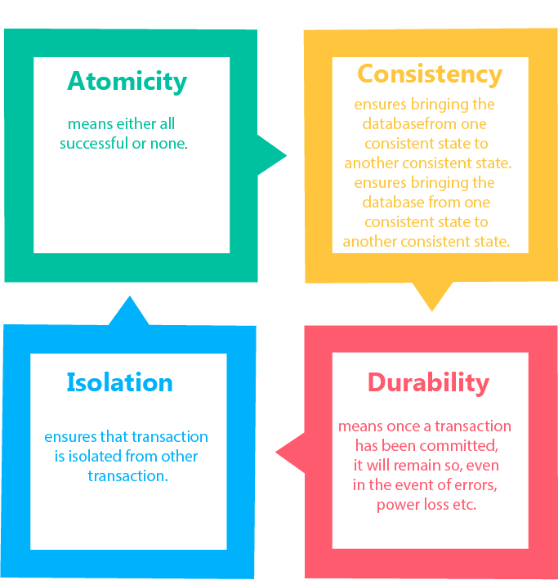
4. Transaction property
The transaction has the four properties. These are used to maintain consistency in a database, before and after the transaction.
Property of Transaction:
Atomicity
Consistency
Isolation
Durability

Slide 53
A) Atomicity
It states that all operations of the transaction take place at once if not, the transaction is aborted.
There is no midway, i.e., the transaction cannot occur partially. Each transaction is treated as one unit and either run to completion or is not executed at all.
Atomicity involves the following two operations:
Abort: If a transaction aborts then all the changes made are not visible.
Commit: If a transaction commits then all the changes made are visible.
Example: Let's assume that following transaction T consisting of T1 and T2. A consists of Rs 600 and B consists of Rs 300. Transfer Rs 100 from account A to account B.
After completion of the transaction, A consists of Rs 500 and B consists of Rs 400.
If the transaction T fails after the completion of transaction T1 but before completion of transaction T2, then the amount will be deducted from A but not added to B. This shows the inconsistent database state. In order to ensure correctness of database state, the transaction must be executed in entirety.
T1 | T2
Read(A) A:= A-100 Write(A) | Read(B) Y:= Y+100 Write(B)

Slide 54
B) Consistency:
The integrity constraints are maintained so that the database is consistent before and after the transaction.
The execution of a transaction will leave a database in either its prior stable state or a new stable state.
The consistent property of database states that every transaction sees a consistent database instance.
The transaction is used to transform the database from one consistent state to another consistent state.
For example: The total amount must be maintained before or after the transaction.
Total before T occurs = 600+300=900
Total after T occurs= 500+400=900
Therefore, the database is consistent. In the case when T1 is completed but T2 fails, then inconsistency will occur.
C) Isolation:
It shows that the data which is used at the time of execution of a transaction cannot be used by the second transaction until the first one is completed.
In isolation, if the transaction T1 is being executed and using the data item X, then that data item can't be accessed by any other transaction T2 until the transaction T1 ends.
The concurrency control subsystem of the DBMS enforced the isolation property.

Slide 55
D) Durability
The durability property is used to indicate the performance of the database's consistent state. It states that the transaction made the permanent changes.
They cannot be lost by the erroneous operation of a faulty transaction or by the system failure. When a transaction is completed, then the database reaches a state known as the consistent state. That consistent state cannot be lost, even in the event of a system's failure.
The recovery subsystem of the DBMS has the responsibility of Durability property.

Slide 56
CONCLUSION
We have learnt how to execute sql commands.
We have Understand The Concept of ER in More Deeper Way
We have learnt to apply database on our mini project website and identify the entities and attributes of our system.
We have implemented the advanced SQL queries
Learns about the procedure and triggers.

Slide 57
Thank You ! ••••••

